Slide 1

To predict cryptocurrency prices using deep learning techniques
Pratik Dhas 22106063
Vaibhav Bura 22106067
Vivek Dalvi 22106108
Yash Desai 22106005
Project Guide
Prof. Mahesh Pawaskar
Notes:
1

Slide 2
Outline
Introduction
Literature Survey of the Existing Systems
Limitations of the Existing Systems
Problem Statement
Proposed System Design
Framework/Algorithm
Technologies Stack for Proposed System
Implementation
Conclusion
References
Notes:
2

Slide 3
Introduction
Bitcoin is a decentralized digital currency without a central authority. Its price is highly volatile, making it challenging to predict.
The outcome is a user-friendly platform that provides both real-time market trends and future price predictions.
Notes:
3

Slide 4
Literature Survey of the existing system
Year | Technique | Performance Metrics | Gap
[1] 2023 | GRU (Gated Recurrent Unit) LSTM (Long Short-Term Memory) BiGRU (Bidirectional GRU) BiLSTM (Bidirectional LSTM) | MAE (Mean Absolute Error) | Limited External Factors Consideration Model Generalization Issues Short-Term vs. Long-Term Forecasting Computational Efficiency and Model Complexity
Notes:
4

Slide 5
Literature Survey of the existing system
Year | Technique | Performance Metrics | Gap
[2] 2022 | Python Scikit-Learn TensorFlow Keras SVR(Support Vector Regression) | MAE (Mean Absolute Error) | Overfitting in Long-Term Learning Limited Dataset Lack of Real-Time Data Handling Feature Selection Bias

Slide 6
Literature Survey of the existing system
Year | Technique | Performance Metrics | Gap
[3] 2024 | Transformer-Based Models (Time-Series Transformer) Temporal Fusion Transformer (TFT) TCN (Temporal Convolutional Network) | RMSE (Root Mean Squared Error) MAE (Mean Absolute Error) | High computational cost Requires large datasets Interpretability challenges Hyperparameter tuning complexity

Slide 7
Literature Survey of the existing system
Year | Technique | Performance Metrics | Gap
[4] 2024 | Hybrid CNN-LSTM Models Attention-based LSTM Graph Neural Networks (GNN) for Time-Series | MAPE (Mean Absolute Percentage Error) -R² Score (Coefficient of Determination) | Struggles with real-time predictions Overfitting on small datasets Lack of standard benchmarks for comparison

Slide 8
Literature Survey of the existing system
Year | Technique | Performance Metrics | Gap
[5] 2024 | Diffusion Models for Time-Series Self-Supervised Learning for Time-Series Reinforcement Learning for Forecasting | Pearson Correlation Dynamic Time Warping (DTW) | Data efficiency issues Lack of robust evaluation methods Requires significant domain expertise for tuning

Slide 9
Limitations of Existing Systems
No real-time stock predictions
Limited accuracy in capturing market patterns
Lacks interactive visualization for better analysis
Requires manual data processing
Does not predict future trends effectively
Struggles with large datasets and scalability
Relies on a single model, reducing prediction reliability
Notes:
9

Slide 10
Problem statement
Bitcoin prices are highly volatile, making accurate predictions challenging
This project provides a data-driven Bitcoin price prediction tool to help investors make informed decisions

Slide 11
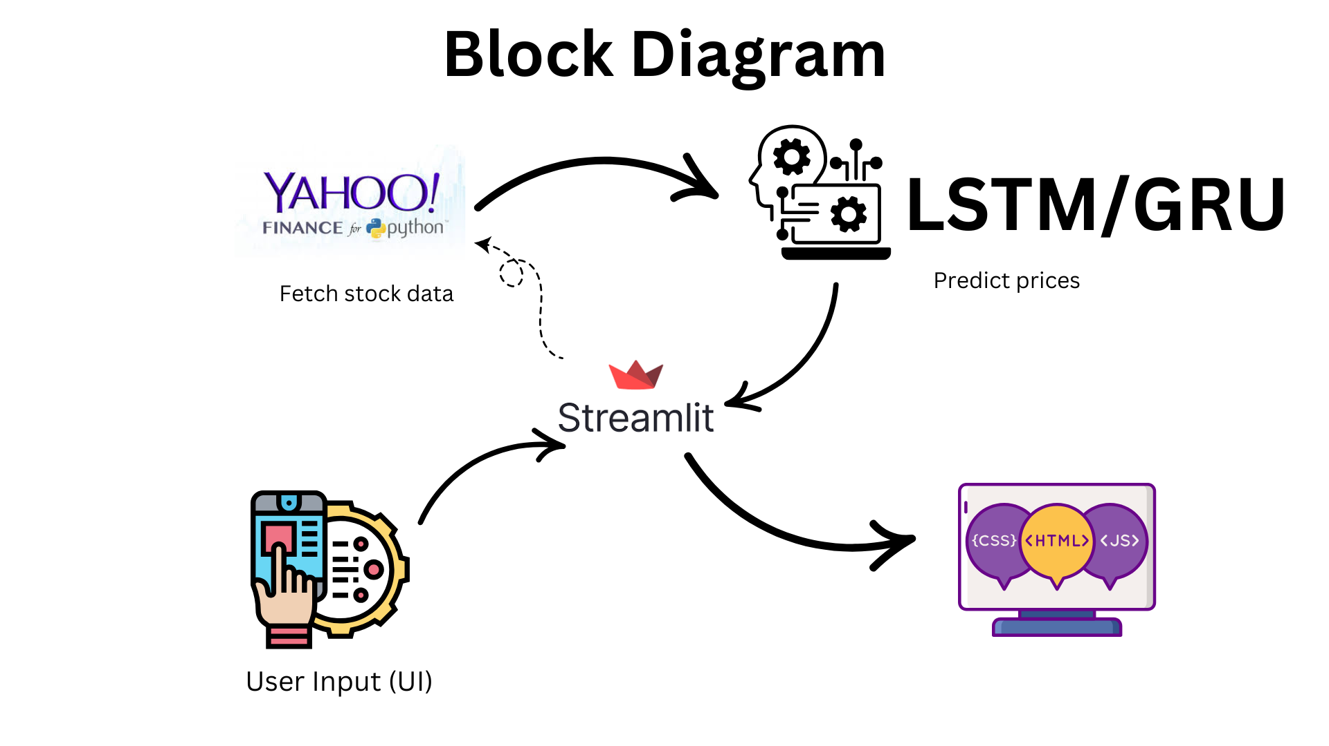
Proposed System Design
Notes:
11

Slide 12
Framework/Algorithm
Streamlit: Used to develop the web application for user interaction.
Keras & Tensorflow: Used for building and training the LSTM model.
Scikit-learn: Used for data preprocessing(MinMaxScaler for normalization).
Matplotlib & Pandas: Used for data visualization and analysis.
Long Short-Term Memory(LSTM): A type of Recurrent Neural Network(RNN) used for time-series forecasting. It effectively captures long-term dependencies in sequential data, making it suitable for Bitcoin price prediction.
Gated Recurrent Unit (GRU): A type of Recurrent Neural Network(RNN) used for time-series forecasting. It effectively captures long-term dependencies in sequential data while being computationally efficient compared to LSTMs.

Slide 13
Technology Stack for Proposed System
The proposed Bitcoin Price Prediction System integrates LSTM and GRU deep learning with real-time financial data visualization.
It collects historical price data via Yahoo Finance, processes it using MinMaxScaler, and predicts future prices with a custom-trained LSTM model and GRU model.
Unlike traditional web frameworks (Flask/Django), Streamlit is lightweight and optimized for ML apps.
Streamlit provides built-in functions like st.line_chart() to visualize Bitcoin price trends instantly
Notes:
13

Slide 14
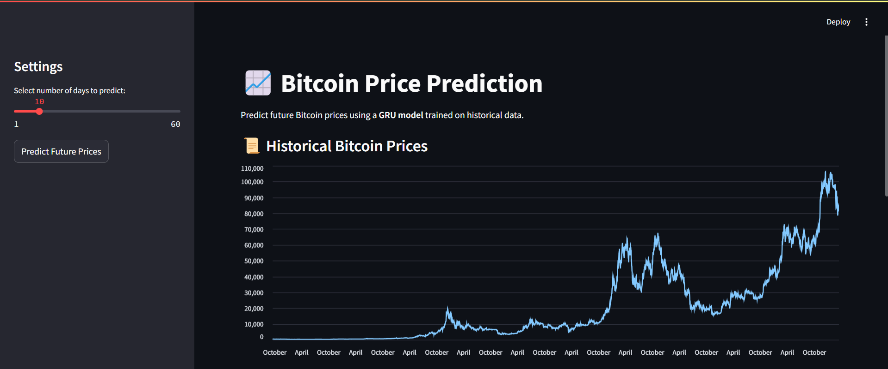
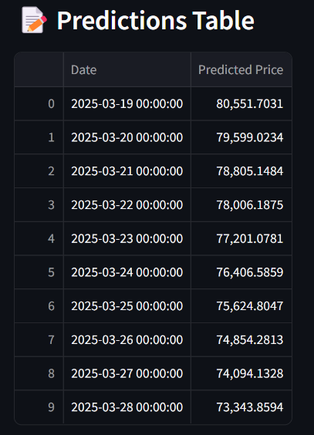
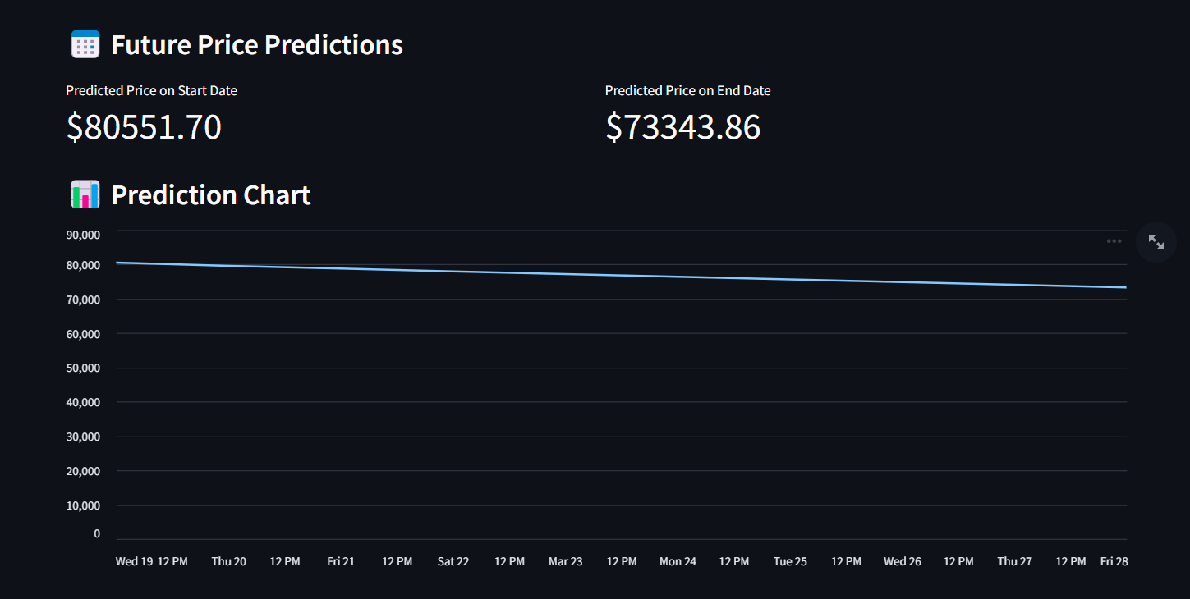
Implementation:
Notes:
14

Slide 15
Conclusion
In this project, we successfully implemented Long Short-Term Memory (LSTM) and Gated Recurrent Unit (GRU) networks, two specialized recurrent neural network architectures, to predict cryptocurrency closing prices based on historical data.
The system was designed to:
Analyze historical Bitcoin price data and extract meaningful patterns.
Predict the next n days prices using deep learning.
Compare actual vs predicted values to assess accuracy.
Notes:
15

Slide 16
References
[1] H. Singathala, J. Malla, J. Jayashree and J. Vijayashree, "A Deep Learning based Model for Predicting the future prices of Bitcoin," 2023 2nd International Conference on Vision Towards Emerging Trends in Communication and Networking Technologies (ViTECoN), Vellore, India, 2023, pp. 1-4
[2] D. Yu, "Cryptocurrency Price Prediction Based on Long-Term and Short-Term Integrated Learning," 2022 IEEE 2nd International Conference on Power, Electronics and Computer Applications (ICPECA), Shenyang, China, 2022, pp. 543-548
[3] M. Mittal and G. Geetha, "Predicting Bitcoin Price using Machine Learning," 2024 International Conference on Computer Communication and Informatics (ICCCI), Coimbatore, India, 2024, pp. 1-7
[4] J. Doe and A. Smith, "Deep Learning-Based Stock Market Prediction Using LSTM and GRU," 2023 IEEE International Conference on Artificial Intelligence and Data Science (ICAIDS), New York, USA, 2023, pp. 55-62.
[5] R. Kumar and P. Sharma, "A Comparative Analysis of Time Series Forecasting Techniques for Cryptocurrency Price Prediction," 2024 International Journal of Data Science and Machine Learning, vol. 12, no. 3, pp. 150-165, 2024.
Notes:
16

Slide 17
Thank You!
Notes:
17

